Slide 1
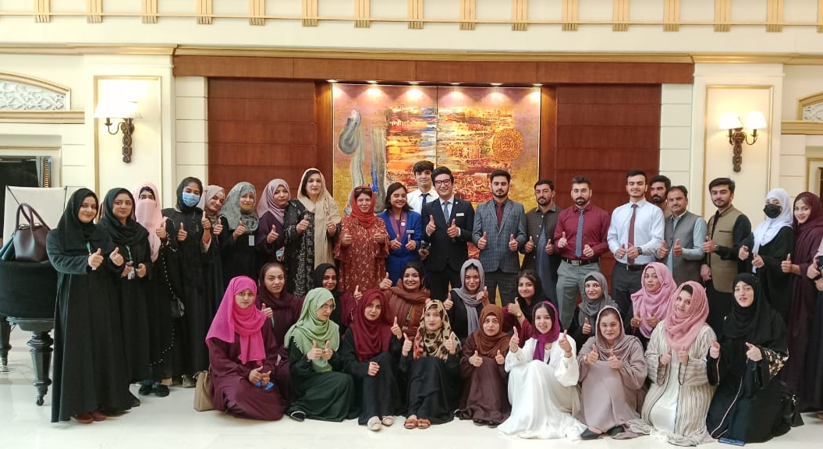

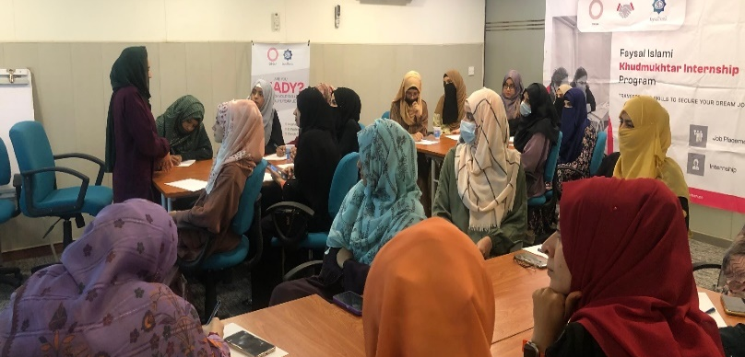
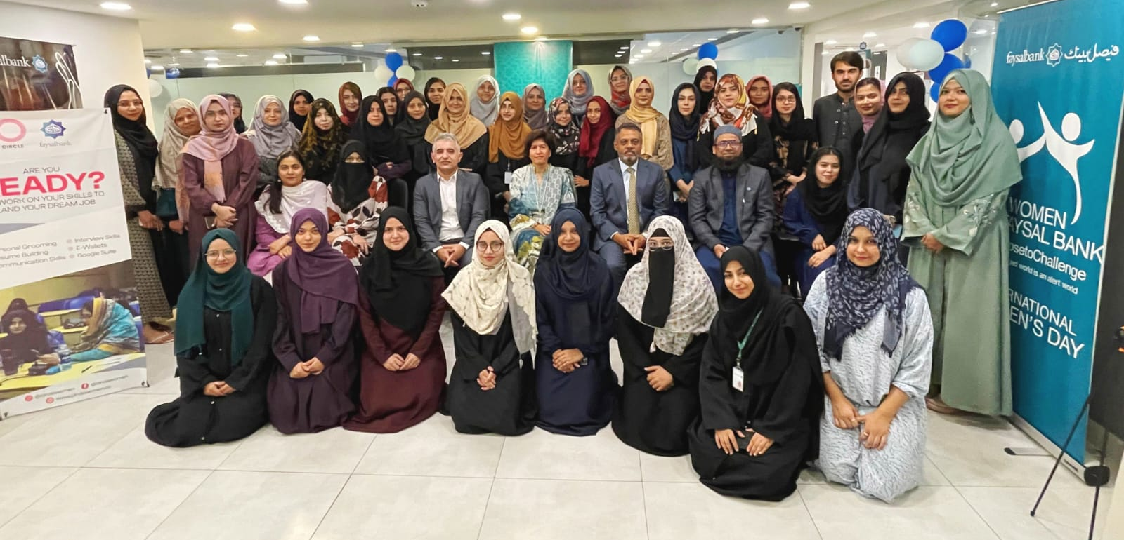

Slide 2
Feedback-TBSA
I appreciated the interactive nature of the classroom sessions, which allowed for open discussions and sharing of experiences.
Aiman .Central –I
I had an amazing time at branch where I gained valuable knowledge. It was a new experience for me. During rotation period I developed relationships building quality which improved my customer services.
Areeba Sheikh- Islamabad
The branch rotation aspect of the training provided valuable hands-on experience and a deeper understanding of the day-to-day responsibilities of a Branch Service Ambassador.
Komal Baloch, Lahore
It has been very interactive sessions. Everything has been explained so well. We have learned Soo much. During rotation period we implemented what we have learnt.
Samreen , Swat
The opportunity to rotate through different branches was instrumental in broadening my perspective and adapting to various work environments.
Rimsha Nisar , South
The trainers demonstrated exceptional knowledge and expertise, making the classroom sessions engaging and valuable.
Rameen Yasin C-II
The classroom sessions effectively covered a wide range of topics relevant to the role, equipping us with the necessary skills and knowledge.
Aqsa Tauseef- Karachi

Slide 3
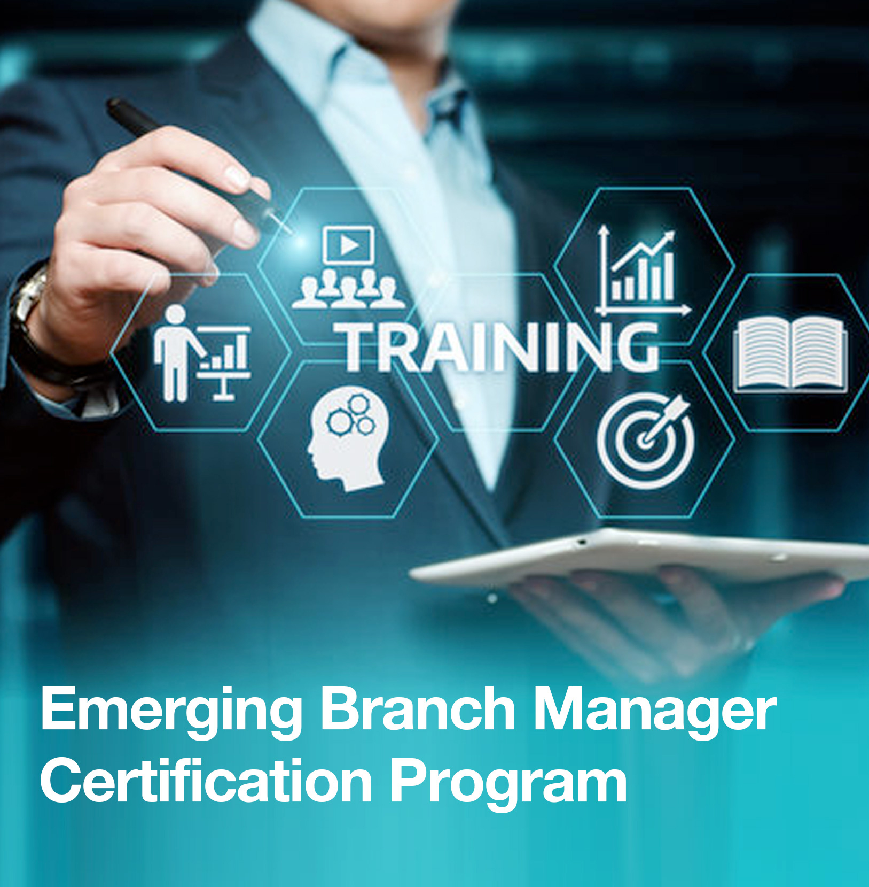
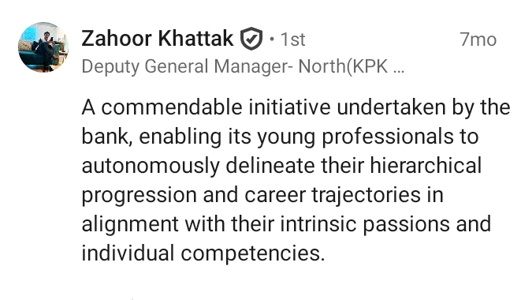
Trade & SME Certification
=> RAZA AHMED KHAN (BM) Training session was very interesting and knowledgeable . I am fully satisfied regarding this training and thanks to learning department for arrangement this session.
=> Imran Ali Zafar (BM) Integrate practical case studies, digital tools, and trade compliance insights to make the SME and Trade course more impactful and future-ready.

Slide 4

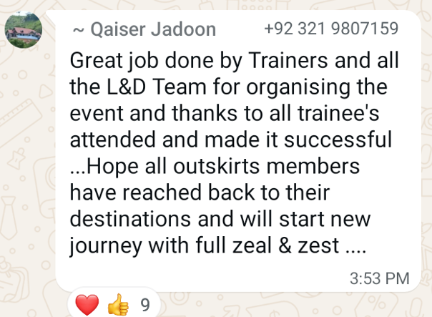
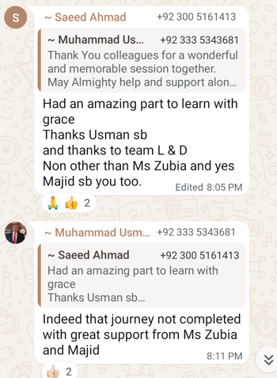
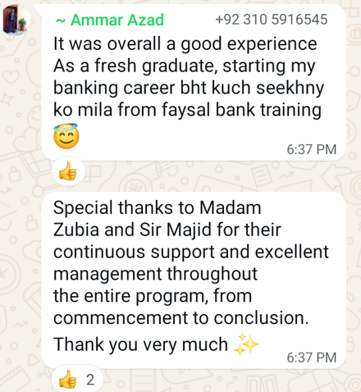
Jumpstart Induction Program

Slide 5

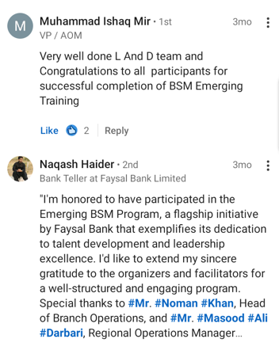
Respected All,
You are cordially invited as Guest Speaker for Opening ceremony of
Emerging Branch Service Manager Certification Program
Highlighting the importance, essential skills & knowledge for future BSMs. Your presence will highlight the significance of governance skills in performing - Leadership roles.

Slide 6

